Slide 1
Comparison of Neighborhoods “Toronto VS New York”
By: Qamar Zia

Slide 2
Background And Motivation
In todays world people are often moving from one place to other for work or for change of life and they also want to be in a place that is much like home. For instance a person comes too you saying that he is moving from New York to Toronto and he is so much confused that where should he find a home in Toronto. By Clustering the two cities on the bases of features we can help the person in his confusion and help him make a decision.

Slide 3
Objectives
Acquiring and Cleaning the data and making it useable for Cluster analysis.
Applying Clustering Algorithm “K-Mean Clustering” for grouping the neighborhoods on bases of similarity features.
Presenting the clusters on Map for better Insights and Vizualization.

Slide 4
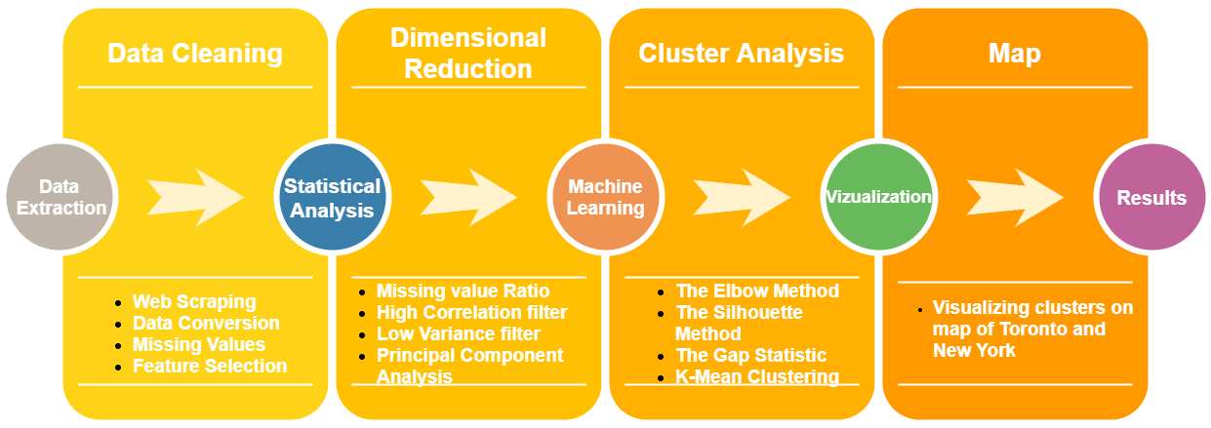
Work Flow

Slide 5
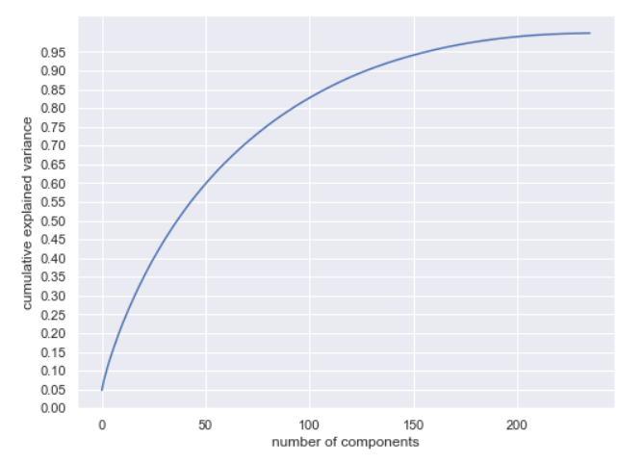
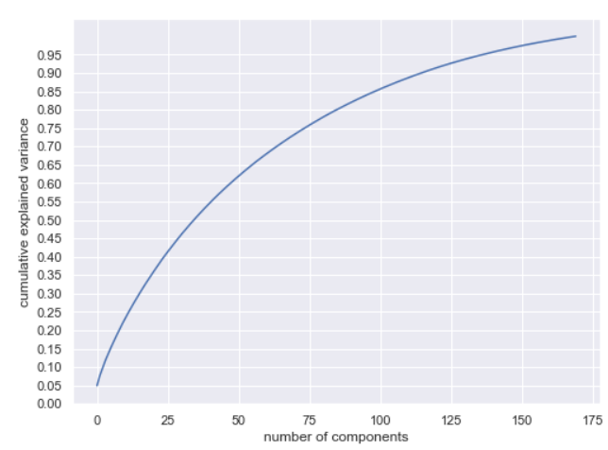
Principal Components
Before Dimensionality Reduction
After Dimensionality Reduction

Slide 6

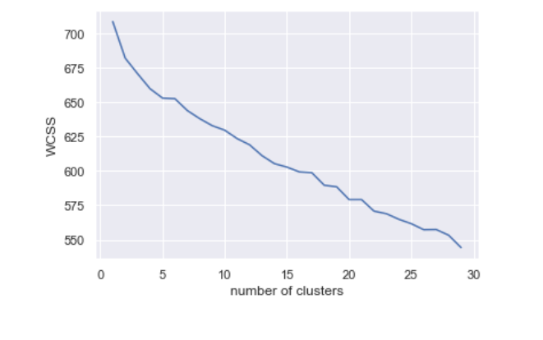
The Elbow Method

Slide 7
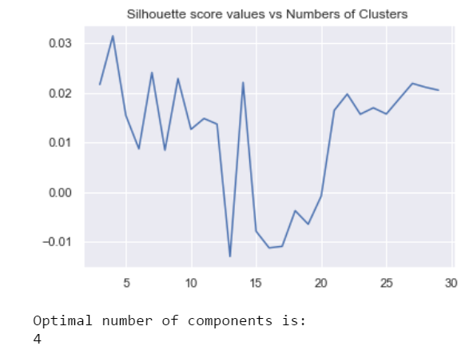
The Silhouette Method

Slide 8
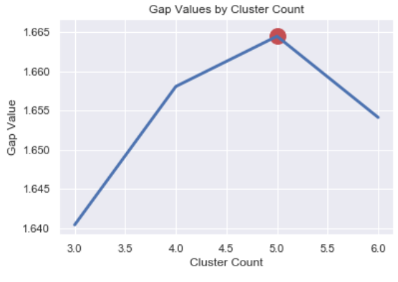
The Gap Statistic Method

Slide 9
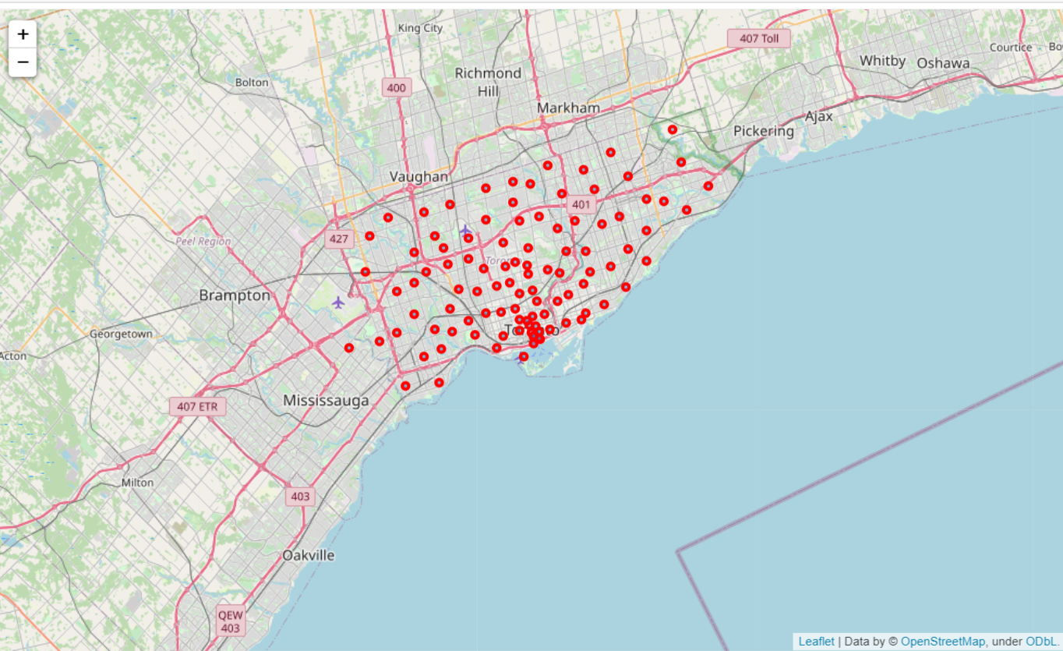
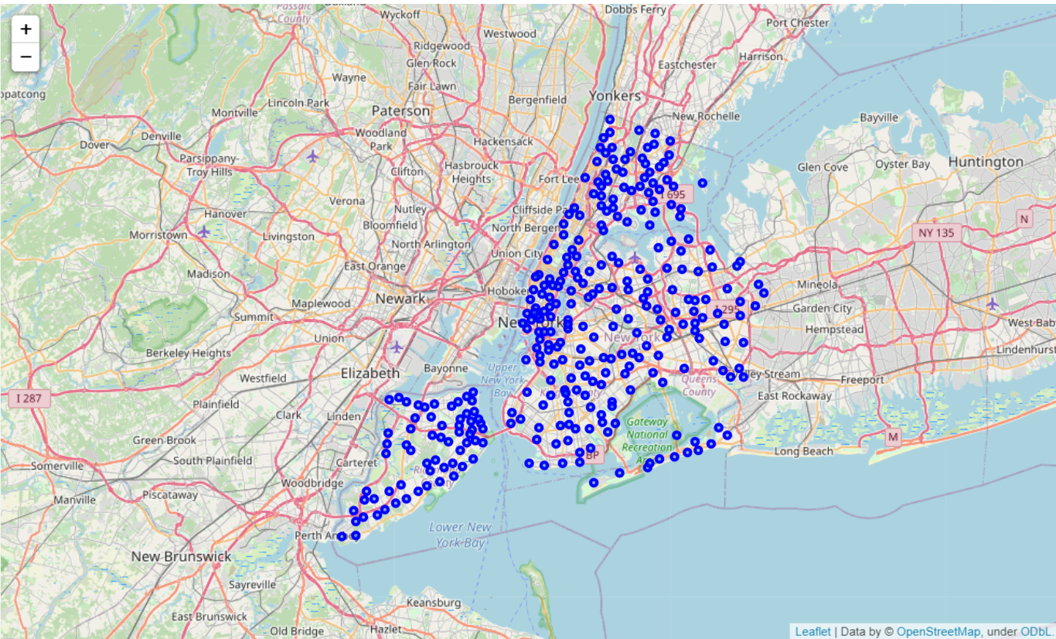
Visualization
Map of Toronto
Map of New York

Slide 10
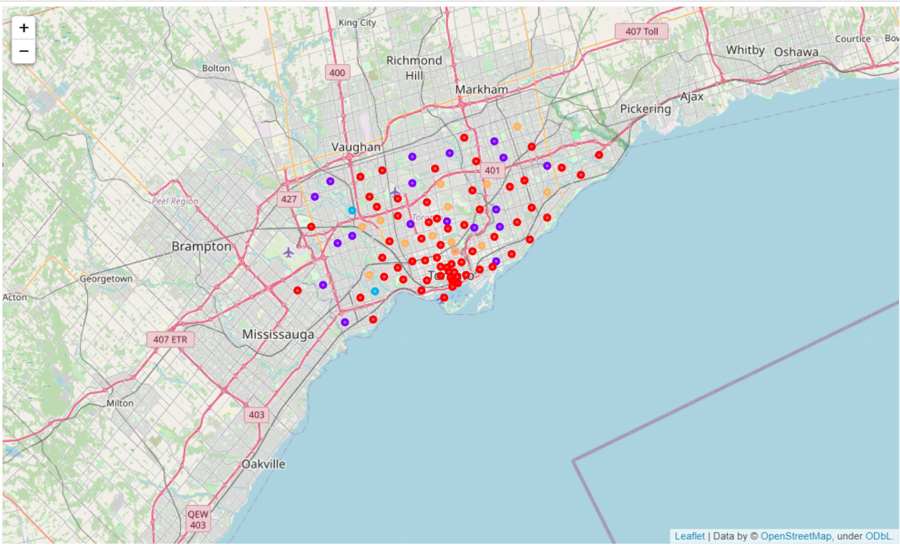
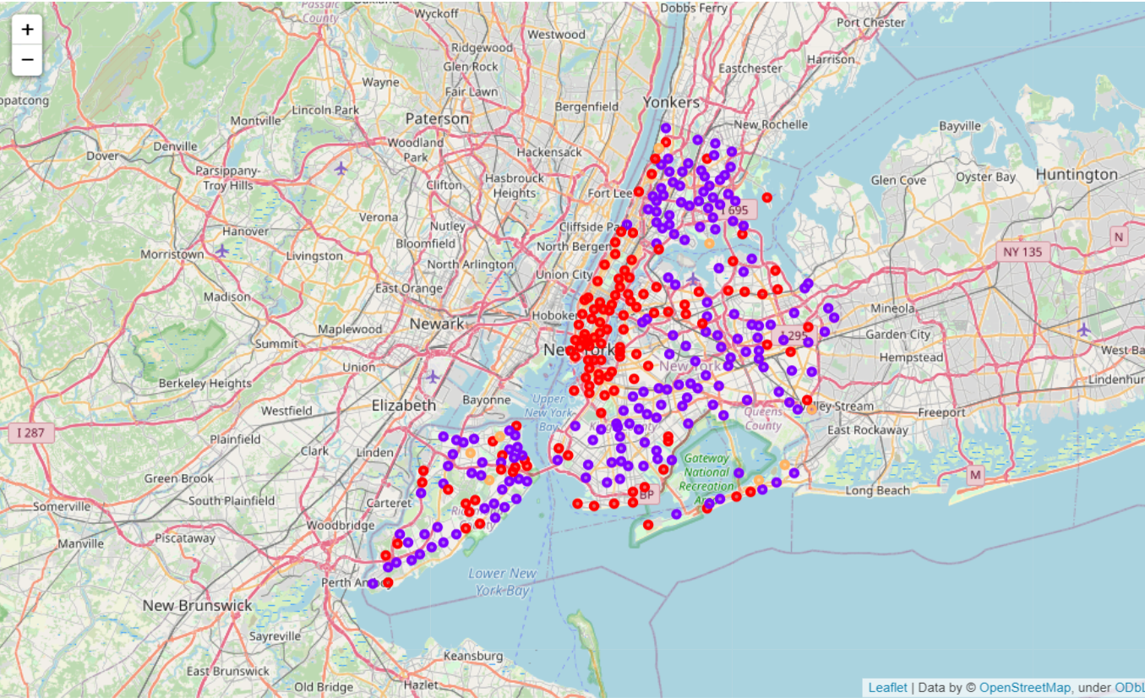
Visualization of Clusters
Clusters of Toronto
Clusters of New York

Slide 11
Conclusion
After clustering and comparing the neighborhoods on maps and comparing them side by side we can easily identify the neighborhoods that are similar in both cities
We can suggest a person a similar neighborhood if he wants to shift from New York to Toronto and still feel like home by having the same common places in the Neighborhood.

